Slide 1

Real World Reinforcement Learning
John Langford
AI Nextcon, NYC, July 23
+Workshop July 25, 9-12
https://vowpalwabbit.github.io/workshop/

Slide 2


Why?
Which News?
Which Game?
28% lift
40% lift

Slide 3


Slide 4
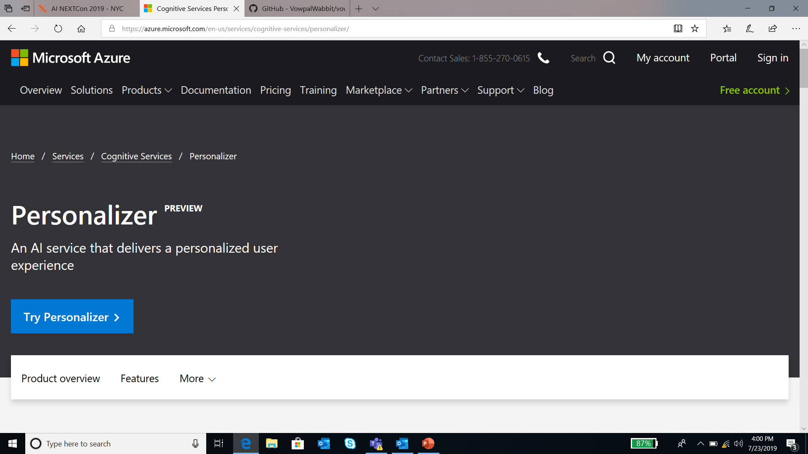

Slide 5


Slide 6
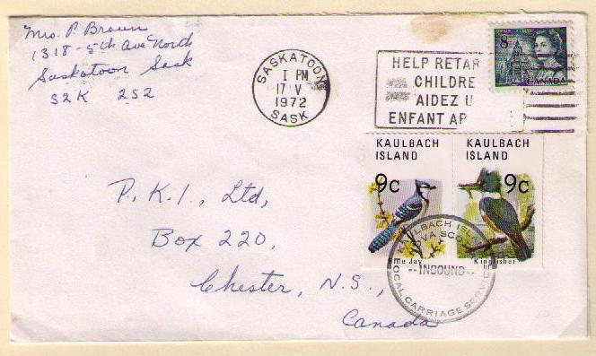
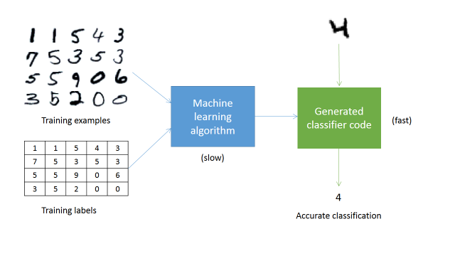
The Baseline: Supervised Learning
1 | 1 | 5 | 4 | 3
7 | 5 | 3 | 5 | 3
5 | 5 | 9 | 0 | 6
3 | 5 | 2 | 0 | 0
Accurate digit classifier
Training examples
Training labels
Supervised Learner
2
Notes:
ML takes a different approach. By applying concepts from a range of fields, including statistics, probability theory, and so on, we can build an ML system that “learns” to recognize handwritten digits by being trained on thousands, or even millions, of examples.
So, in order to get an accurate digit classifier, all we need to do is acquire lots of training examples, with labels (this is called “labeled training data”), and then feed it into the ML system.

Slide 7
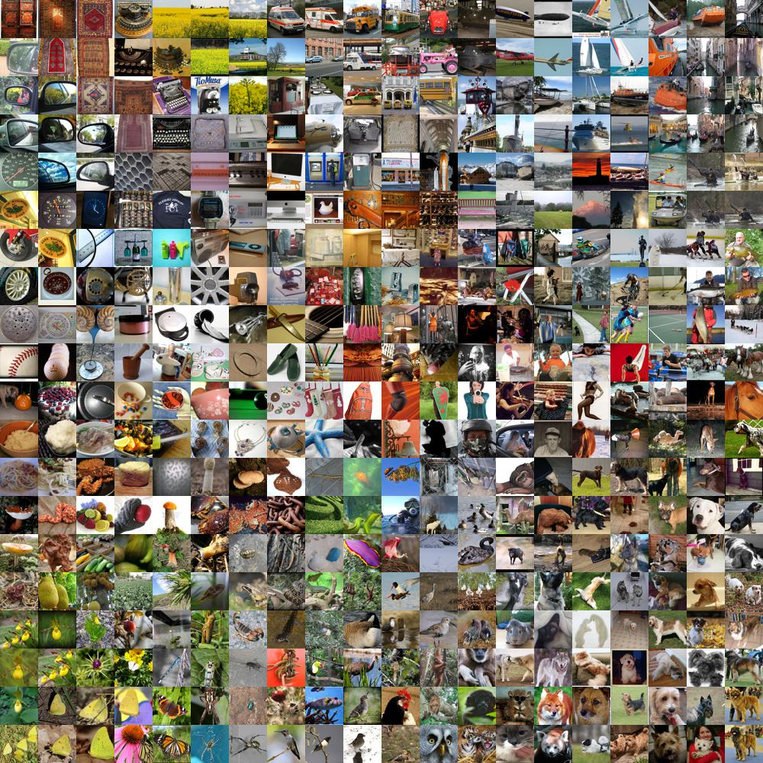

Supervised Learning is cool

Slide 8



How about news?
Notes:
Add Wellness

Slide 9
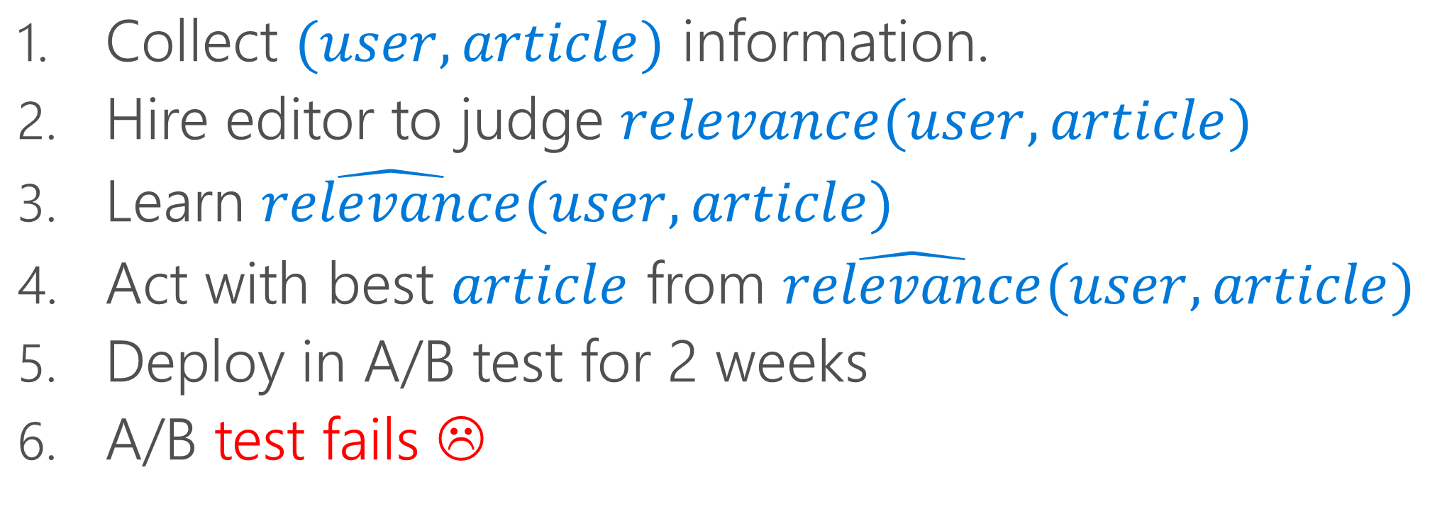
A standard pipeline
Collect $(user, article)$ information.
Hire editor to judge $relevance(user,article)$
Learn $\hat{relevance}(user,article)$
Act with best $article$ from $\hat{relevance}(user,article)$
Deploy in A/B test for 2 weeks
A/B test fails ☹

Slide 10
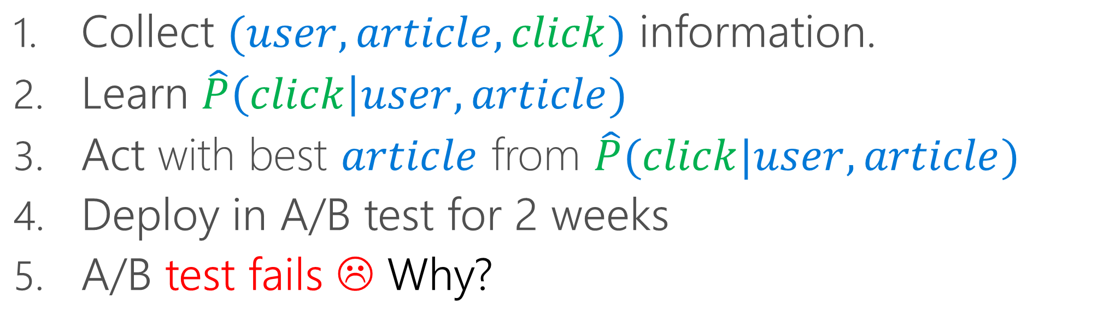
A standard pipeline
Collect $(user, article, click)$ information.
Learn $\hat{P}\left(click\right|user,article)$
Act with best $article$ from $\hat{P}(click|user,article)$
Deploy in A/B test for 2 weeks
A/B test fails ☹ Why?

Slide 11


Q: What goes wrong?
Is Ukraine interesting to John ?
A: Need Right Signal for Right Answer

Slide 12


What goes wrong?
What is the probability of click on a food article
If you only display a space article?
We must avoid “self-fulfilling prophecy”

Slide 13
What else goes wrong?
The world changes!

Slide 14


Can we optimize for best outcome?
Amongst a given set of choices?
For what matters to individuals?
Without self-fulfilling prophecies?
With real-time learning?

Slide 15

Reinforcement Learning can do this!
Action
Policy ?
Observation
Reward
Goal: Find a policy maximizing the sum of rewards

Slide 16

Q: One last Why…
AI: A function programmed with data
AI: A function programmed with data
AI: An economically viable digital agent that explores, learns, and acts

Slide 17


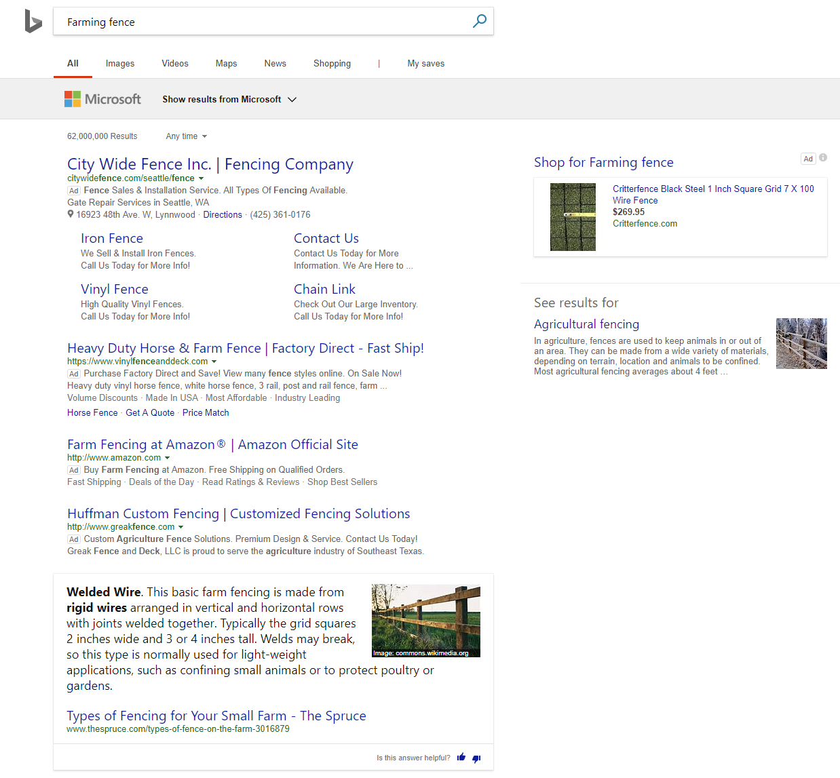

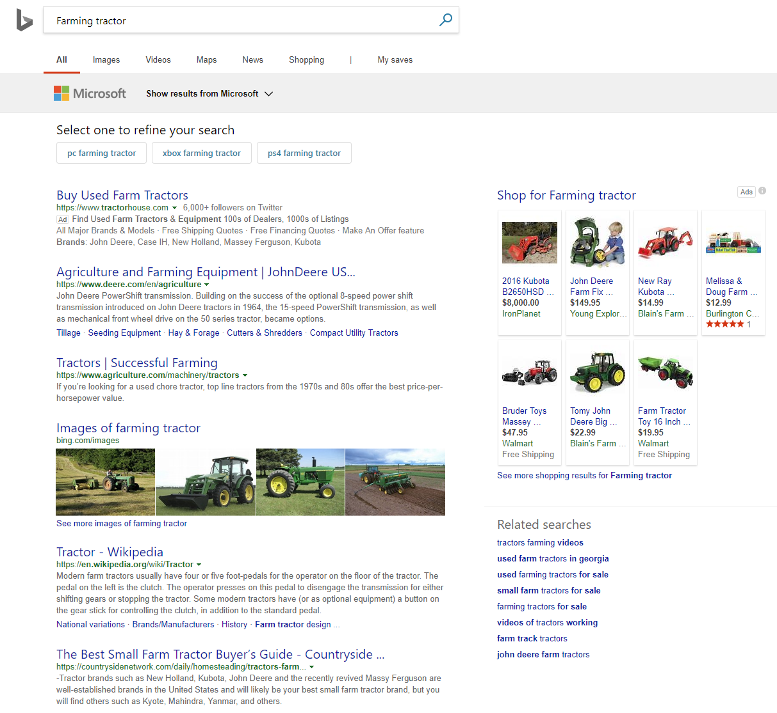


Content
Layout
Creative
“Book Your Vacation to Hawaii”

Slide 18
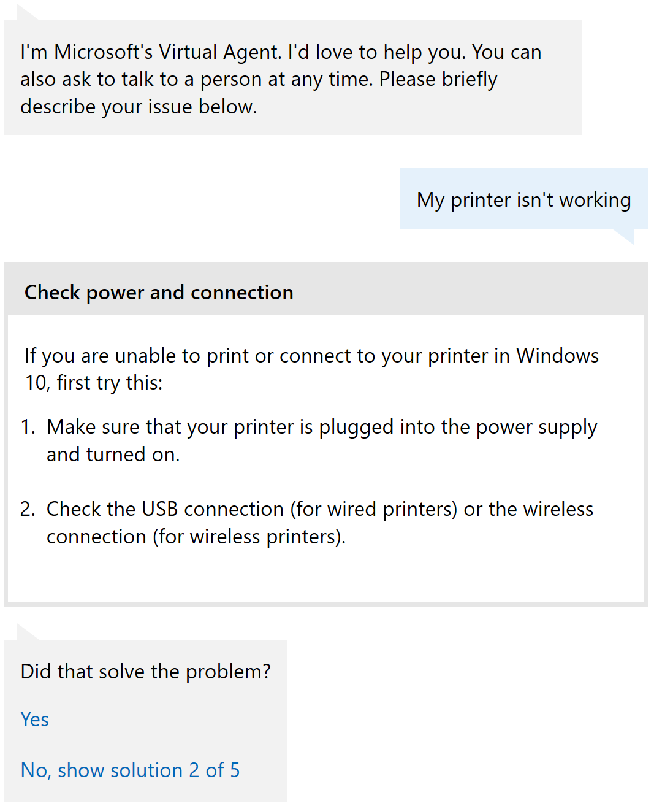


Wellness
Bots
[ZKZ ’09, SLLSPM ’11, NSTWCSM ’14, PGCRRH ’14, NHS ’15, KHSBATM ‘15, HFKMTY ’16]

Slide 19
Other Real-world Applications
Ad Choice: [BPQCCPRSS ‘12]
Ad Format: [TRSA ‘13]
Education: [MLLBP ‘14]
Music Rec: [WWHW ‘14]
Robotics: [PG ‘16]

Slide 20
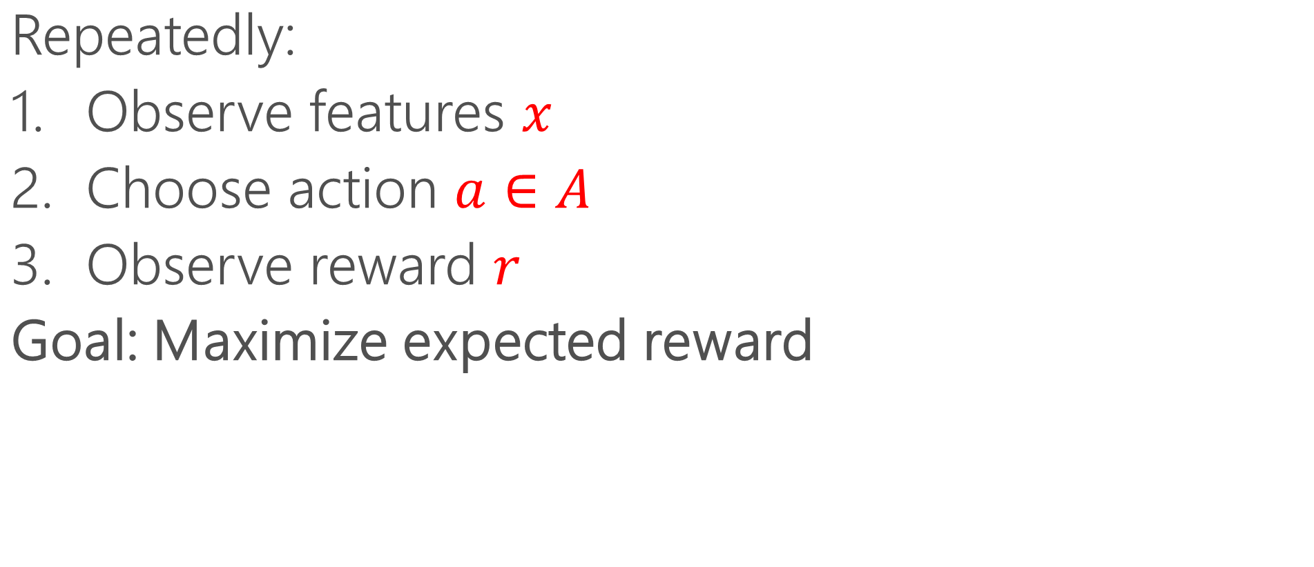
Formalism: Contextual Bandits
Repeatedly:
Observe features $x$
Choose action $a∈A$
Observe reward $r$
Goal: Maximize expected reward

Slide 21


Policies
Policy maps features to actions.
Policy = Classifier that acts.

Slide 22



Why does it work?
Exploit for performance
“Exploit”= use best known inference
“How much should I explore to discover how to best perform?”
x%
Policy
Explore to discover new things
“Explore” = try other alternatives

Slide 23
Counterfactual Evaluation
…
Policy ?
Policy ?
Policy ?
Policy ?
Tests can use the same events!
Read
Read
Ignored
Read
Later evaluate Location rule:
Later evaluate Career rule:
Teacher
Engineer
Engineer
Engineer
Texas
Seattle
Seattle
Texas

Slide 24


A/B vs. Counterfactual
A
Exploit best known inference
Exploration Policy
B
Explore new alternatives
x1
x100,000
A/B Test:
Design the Right Experiment,
Test online once
Start over
Offline Experiment:
Use models that exploit and explore
Record User Interaction
Find the policy and model that fits reality

Slide 25
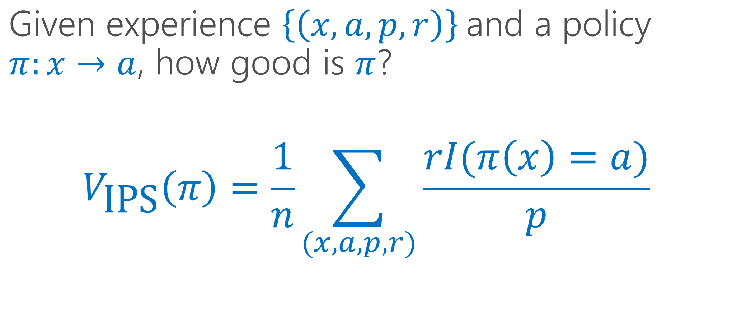
Inverse Propensity Score(IPS)
Given experience ${\left.\left\{\left(x,a,p,r\right)\right.\right\}}^{ }$and a policy $π:x→a$, how good is $π$?
$$V_{\text{IPS}}\left(π\right)=\frac{1}{n}\sum_{(x,a,p,r)}{\frac{rI(π\left(x\right)=a)}{p}}$$
Propensity Score

Slide 26
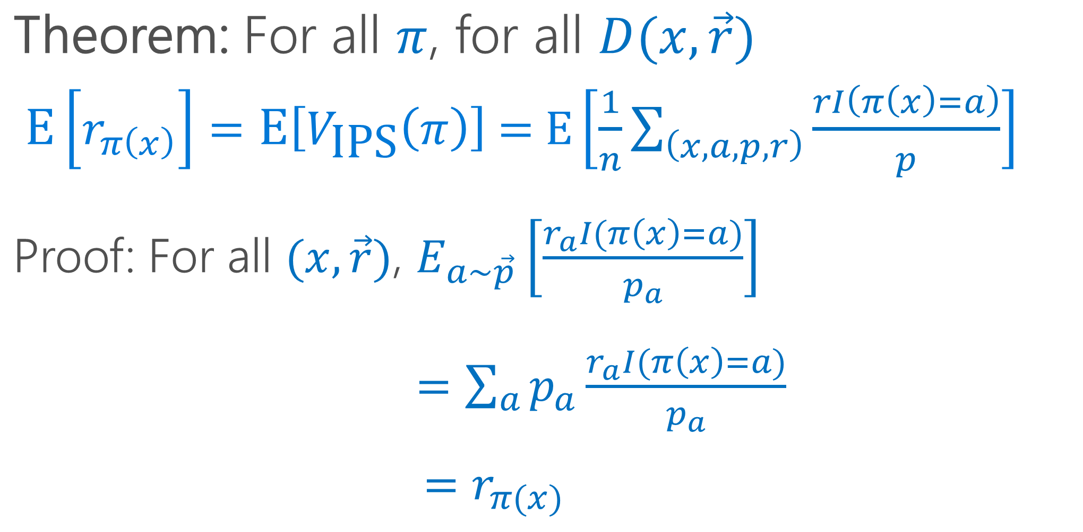
What do we know about IPS?
Theorem: For all $π$, for all $D(x,\vec{r})$
$\left.\text{E}\left[r_{π\left(x\right)}\right.\right]=\text{E}\left.\left[V_{\text{IPS}}\left(π\right)\right.\right]\text{ = }\text{E}\left[\frac{1}{n}\sum_{\left(x,a,p,r\right)}{\frac{rI\left(π\left(x\right)=a\right)}{p}}\right]$
Proof: For all $(x,\vec{r})$, $E_{a∼\vec{p}}\left[\frac{r_{a}I(π\left(x\right)=a)}{p_{a}}\right]$
$=\sum_{a}{p_{a}\frac{r_{a}I(π\left(x\right)=a)}{p_{a}}}$
$=r_{π(x)}$

Slide 27
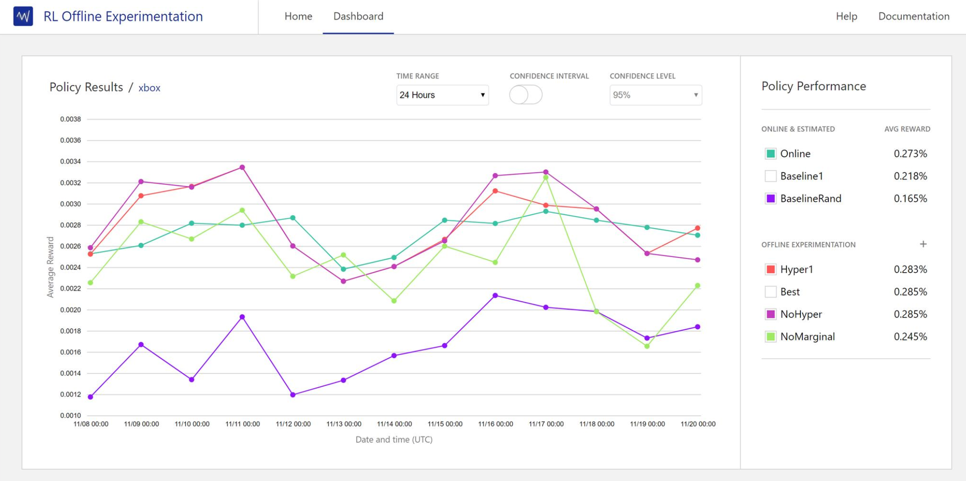
Why Explore? You can do learning
Better learning Policies discovered automatically
Personalizer Current Model
Your application’s baseline
Random
Notes:
Counterfactuals
Make the most of RW data
No sim,

Slide 28
Better Evaluation Techniques
Double Robust: [DLL ‘11]
Weighted IPS: [K ’92, SJ ‘15]
Clipping: [BL ’08]
Empirical Likelihood: [MKL ’19]

Slide 29
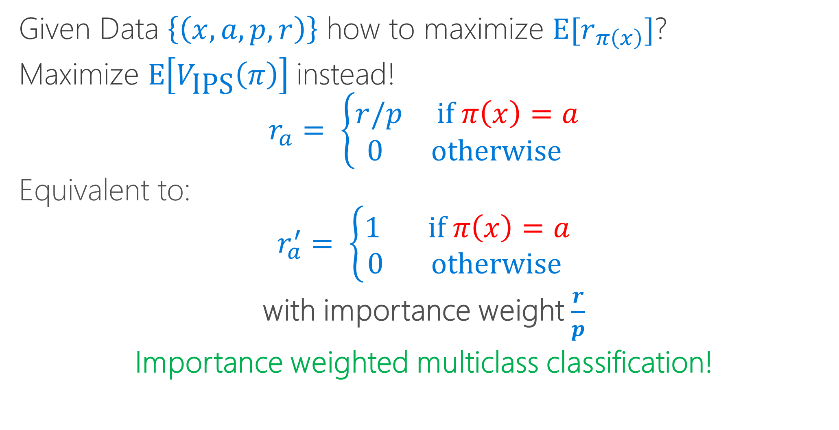
Learning from Exploration
Given Data $\left\{\left(x, a, p,r\right)\right\}$ how to maximize $\text{E}[r_{π\left(x\right)}]$?
Maximize $\text{E}\left[V_{\text{IPS}}\left(π\right)\right]$ instead!
$$r_{a}= \left\{\begin{aligned}r/p \text{if} π\left(x\right)=a \\ 0 \text{otherwise} \end{aligned}\right.$$
Equivalent to:
$$r_{a}^{′}= \left\{\begin{aligned}1 \text{if} π\left(x\right)=a \\ 0 \text{otherwise} \end{aligned}\right.$$
with importance weight $\frac{r}{p}$
Importance weighted multiclass classification!

Slide 30
Better Learning from Exploration
Policy Gradient: [W ‘92]
Offset Tree: [BL ’09]
Double Robust for learning: [DLL ‘11]
Multitask Regression: [BAL ‘18]
Weighted IPS for learning: [SJ ‘15]

Slide 31
Evaluating Online Learning
Problem: How do you evaluate an online learning algorithm Offline?
Answer: Use Progressive Validation [BKL ’99, CCG ‘04]
Theorem:
1) Expected PV value = Uniform expected policy value.
2) Trust like a test set error.

Slide 32
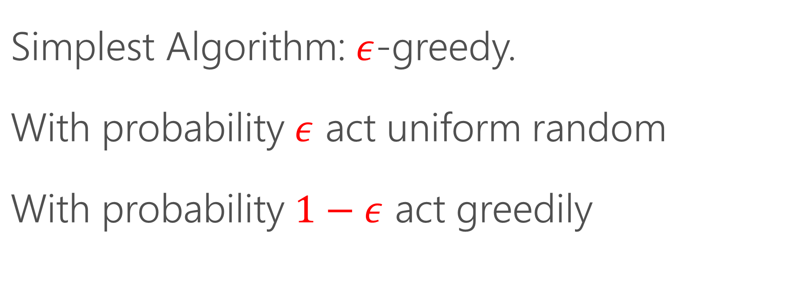
How do you do Exploration?
Simplest Algorithm: $ε$-greedy.
With probability $ε$ act uniform random
With probability $1−ε$ act greedily

Slide 33
Better Exploration Algorithms
Better algorithms maintain ensemble and explore amongst actions of this ensemble.
Thompson Sampling: [T ‘33]
EXP4: [ACFS ‘02]
Epoch Greedy: [LZ ‘07]
Polytime: [DHKKLRZ ‘11]
Cover&Bag: [AHKLLS ‘14]
Bootstrap: [EK ‘14]

Slide 34
Evaluating Exploration Algorithms
Problem: How do you take the choice of examples acquired by an exploration algorithm into account?
Answer: Rejection Sample from history. [DELL ‘12]
Theorem: Realized history is unbiased up to length observed.
Better versions: [DELL ’14]

Slide 35
More Details!
AI Nextcon Workshop, July 25 9-12 https://vowpalwabbit.github.io/workshop/
Personalizer Service: http://aka.ms/personalizer
Vowpal Wabbit: http://vowpalwabbit.org
ICML tutorial: http://hunch.net/~rwil

